Slide 1

Buyer and Seller Networking Opportunity:
University and R&D focus session
University Professor Dr.iur. Zhang Naigen
Director

Slide 2
Two Points
A brief introduction to Fudan University and institutional framework of R/D and industrialized technology
Fertile breeding ground for breakthrough technology and turning your Innovation into revenue

Slide 3


Fudan University
Fudan University was the first Chinese modern university established in 1905 by Mr. Ma Xiangbo (马相伯).
Today, Fudan University is comprehensive
one including disciplines of art, science
and medicine after merging Shanghai
University of Medicine in 2000.

Slide 4

Natural science / engineering and medicine
http://www.fudan.edu.cn/en/channels/view/61/

Slide 5
Mathematics
School of Mathematics and Science
Physics
Department of Physics
Chemistry
Department of Chemistry
School of Information Science and Technology
School of Computer Science
School of Software Engineering
School of Microelectronics
Department of Materials Science
Department of Mechanics and Engineering Science
Department of Environmental Science and Engineering
Department of Macromolecular Science
Department of Nuclear Science and Technology

Slide 6


Life Science
School of Life Science
Medicine
School of Basic Medicine
Pharmacy
School of Pharmacy
School of Clinical Medicine
Affiliated Hospitals

Slide 7
State Key Laboratories (SKL)
Lab of Surface Physics
Lab of Genetic Engineering
Lab of Molecular engineering of Polymers
Lab of Medical Neurobiology
Lab of Application-Specific Integrated Circuits and Systems

Slide 8
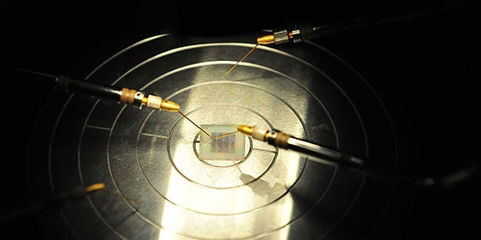
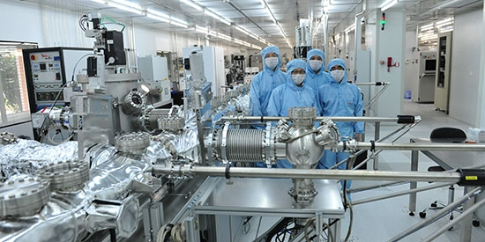
Recent breakthrough technologies:
First Semi-Floating-Gate Transistor (SFGT) in World

Slide 9
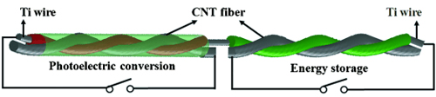
Recent breakthrough technologies:
Solar cell and Super Capacitor

Slide 10

industrialized technologies
Currently 480 enterprises make up the Science and Technology Center, of which about 60% are electronic information enterprises. Fudan is a financial backer or holds shares in 40% of the park’s enterprises. The park has a large number of high-tech enterprises and elite innovation enterprises including Fudan Microelectronics, Fudan Guanghua, TCSoft, and Fudan Water which are the focus of much industry attention.

Slide 11

Fertile breeding ground for breakthrough technology and turning your Innovation into revenue
Fudan Microelectronics

Slide 12
Shanghai Fudan Microelectronics Group Co., Ltd. is one of the leading companies specialized in the design and development of ASIC and the provision of total solution in China.
In July 1998, Shanghai Commercial Investment Company, ASIC & System State-Key Laboratory of Fudan University and a group of founders with dreams and pioneer spirits established Fudan Microelectronics.

Slide 13
ASIC & System State-Key Laboratory of Fudan University and Fudan Microelectronics
ASIC & System State-Key Laboratory of Fudan University contributed 10 key technologies as 37% investments of Fudan Microelectronics
Both cooperated to establish the joint Center of Integrated Circuit Engineering Technology

Slide 14

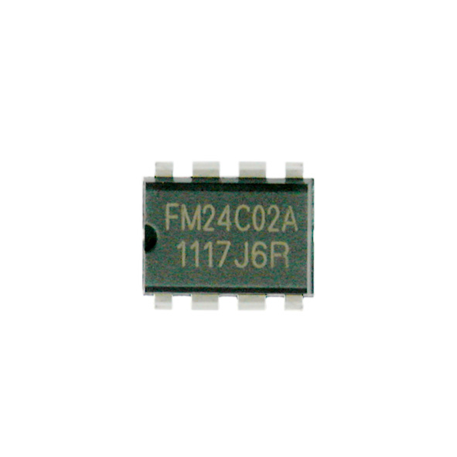
FM24C02A - 2-Wire Serial CMOS EEPROM
FM24C02A provides low operation voltage of 2048 bits of serial electrically erasable and programmable read-only memory( EEPROM ) organized as 256 words of 8 bits each. The device is optimized for use in many industrial and commercial applications where low-power and low-voltage operations are essential.

Slide 15
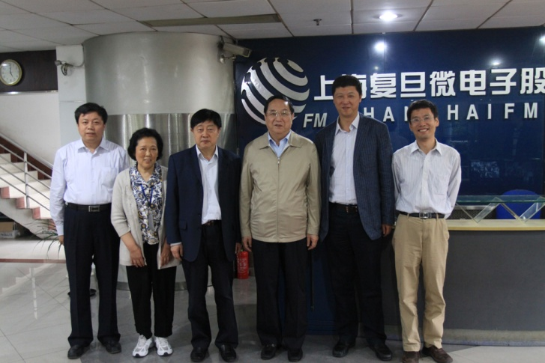
Intellectual Property Protection
Patent application: 103
Patent granted: 57
Registration of integrated circuit：34
including the first IC registration In China
The best model of
industrialized
technologies

Slide 16
Conclusion
How to fertile breeding ground for breakthrough technology and turning your Innovation into revenue ?
1. essential investment of R/D
2. industrialize new technologies
3. cooperation between university and company
4. protection for intellectual property rights

Slide 17

Thank you very much
Q & A
Fudan IP Center website
http://www.ipcenter.fudan.edu.cn/

