Slide 1

“Belt & Road”-Related IPR Customs Enforcement:
China-EAEU, China-EU Cooperation
Zhang Naigen
University Professor , Fudan University

Slide 2
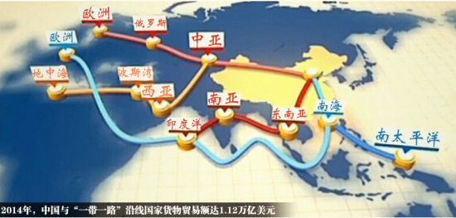
Map of Belt & Road

Slide 3
Legal Issues of Customs Related to Trade in Goods of Belt & Road
WTO
Trade Volumes with Countries in Belt & Road was 947.8 billion US$ in 2016.
It is expected to be 2.5 trillion US$ in 2020.
Customs cooperation
Bilateral agreements
Trade Facility
GATT Art. 5 & TFA
Customs IPR Enforcement
TRIPS Art. 51 & foot 13

Slide 4
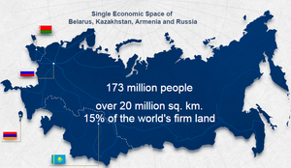
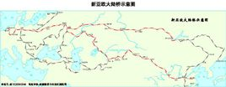
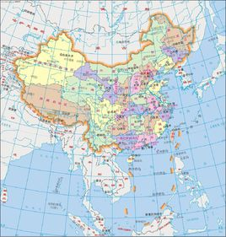
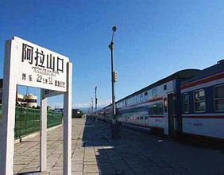
Cooperation between Economic Belt of Silk Road and Eurasian Economic Union (EAEU)
New Eurasian Land Bridge (railway)
China’s Alataw Pass via Kazakhstan
Destined to
EU

Slide 5
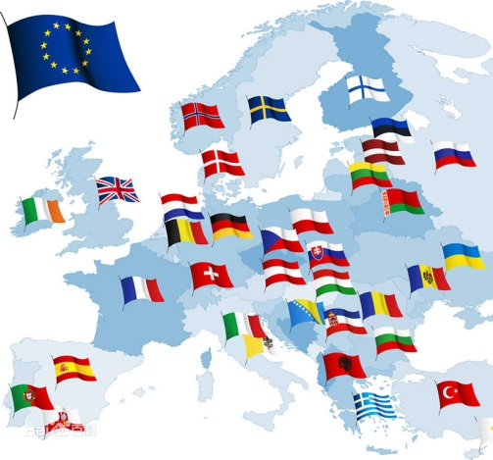
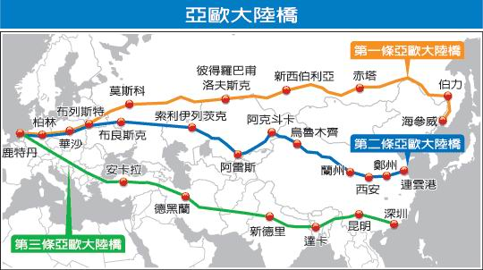
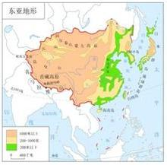
Cooperation between Economic Belt of Silk Road and European Union (EU)
Three Eurasian Railways
The new one is mostly significant for China-EU trade
EU
East Asia
Goods in Transit from East Asia to EU

Slide 6
Customs IPR Enforcement by China-EAEU, EU Cooperation

Slide 7
Customs Cooperation between
China and EAEU
China has bilateral customs cooperation agreements with Russia, Belarus, Kazakhstan, Kyrgyzstan and Uzbekistan, but not with EAEU.
EAEU Customs Code 2016 based on 2010 edition
The Customs IPR enforcement shall be taken if the signs of violation of the IPR are founded.
China must have Sino-US, Sino-EU style customs cooperation agreement with EAEU.

Slide 8
Customs IPR Cooperation between China and EAEU
China has customs IPR cooperation with Russia in 1994, but no with Belarus, Kazakhstan, Kyrgyzstan and Uzbekistan.
2014, China customs detained suspected goods infringing IP, the destination to Russia was 3rd in the term of number of actions.
the Article 2.1(2) of China-Russian agreement on customs cooperation requires the customs authorities of two parties to cooperate with each other and provide mutual assistance including prevention, examination and punishment of any violations of customs laws and regulations in their competence under domestic laws.
It shall be updated and as a model for other EAEU members

Slide 9
Customs IPR Cooperation between China and EU
The existing China-EU agreements on customs cooperation in 2004
The action plan on IPR customs enforcement in 2009
The strategic framework on customs cooperation including on IPR enforcement in 2010.
China-EU cooperation on IPR customs enforcement is moving to the new step of exchanging information of suspected IPR infringements between competent customs bodies of China and the EU under the new action plan of IPR (2014-2017).

Slide 10
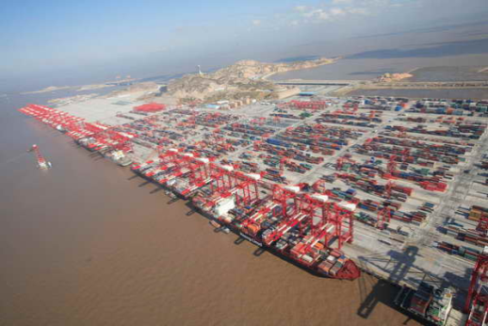


New Case of China-EU Cooperation on IPR Custom Enforcement
The recent case was published in April 2015 as a successful cooperation between Shanghai and Hamburg customs officials regarding the counterfeit sport shoes infringing famous brand “Nike” in amount of pairs 10164 and of values over 5 million RMB.
SHFTZ
Goods in Transit
Hamburg

Slide 11
China IPR Customs Enforcement in Special Surveillance Zone
Alashankou special customs area is only one connecting Silk Road Economic Belt to EAEU, and may be destined to EU .
Special customs surveillance zone is the “grey” area for IPR enforcement in China and must be improved.

Slide 12
Thanks

